Slide 1

Analysis
Not pleasing
Hard to control the volume
Gel comes out of the tip making a mess
Assemble and disassemble is hard
Mixing tip cap is easy to lose
Customer

Slide 2
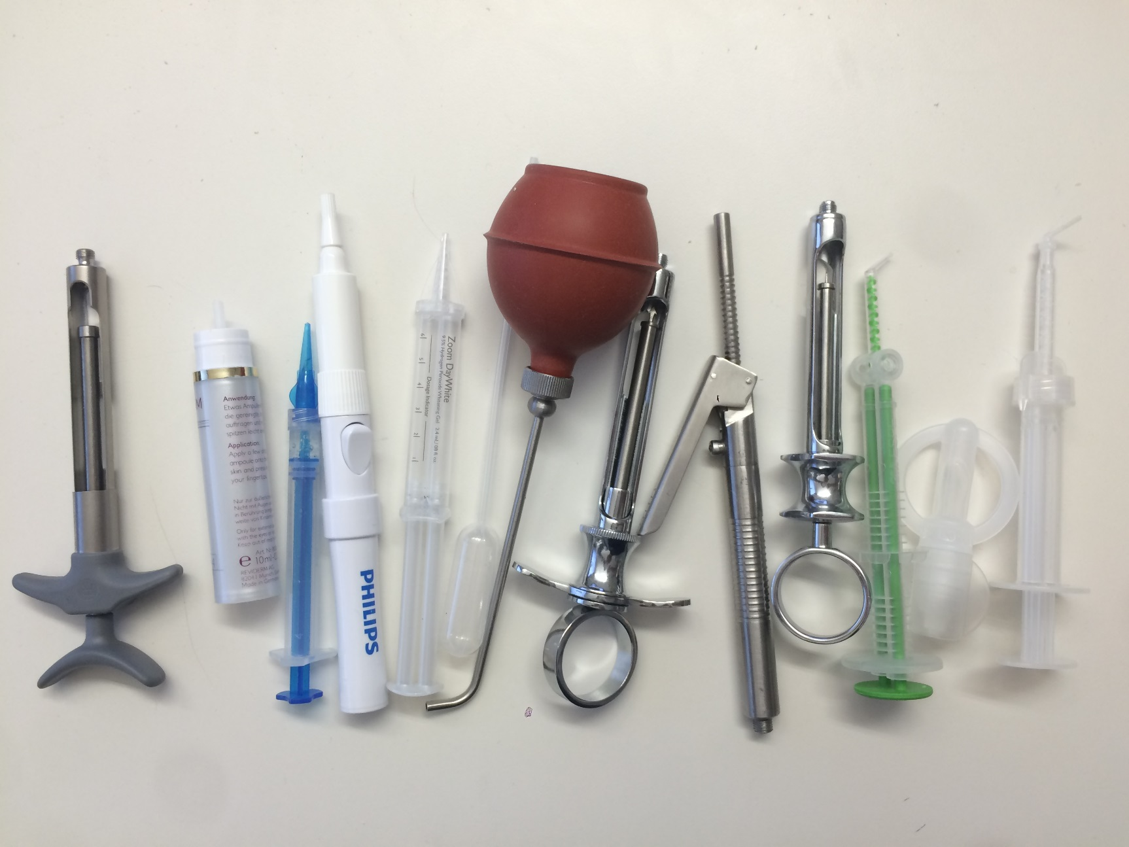
Other Dispenser

Slide 3
Summary of Brainstorm
50 concepts total
Quick closing
Internal and external spring
Pull back with bulge
One way valve
Reduce size of mixing tip
Hard to control the volume
(10)
Control with vision
Control with tactility/Sound
Single use
Glue gun
Gel comes out of the tip making a mess
(10)
Disposable dispenser
More tips or mixing tip caps
Integrate the cap to box
Connect the cap to syringe
Enlarge the cap
Mixing tip cap is easy to lose
(9)
Assemble and disassemble is hard
(8)
One way valve
Integrate the mixing tip and syringe cap
Not pleasing
(13)
Cylinder outer box
Paint syringe
Electrical design
Future style

Slide 4
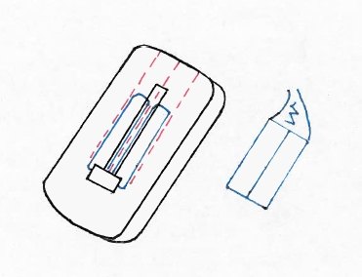
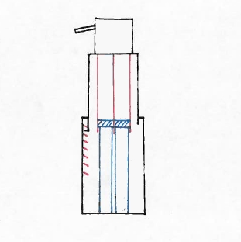
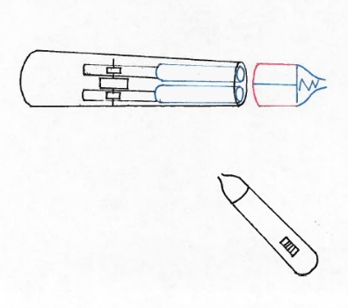
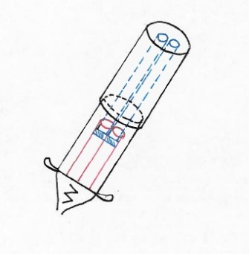
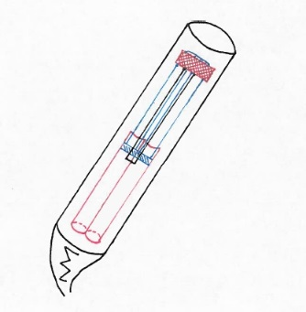
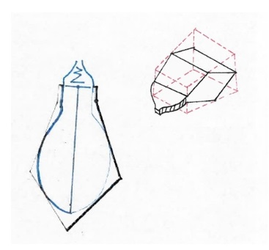
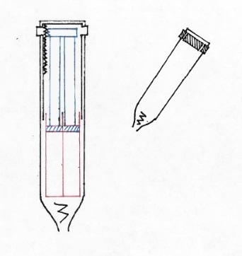
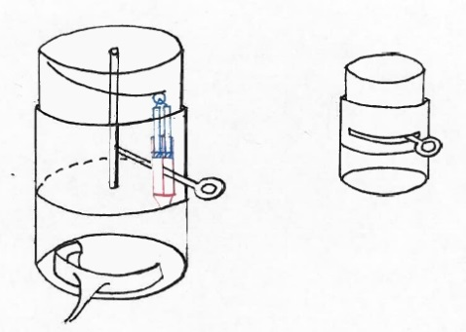
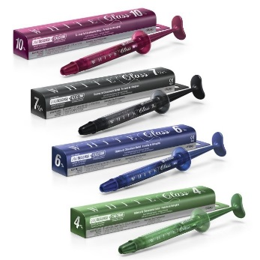
Concepts from Brainstorm
Concept-1 | Concept-2 | Concept-3
Concept-4 | Concept-5 | Concept-6
Concept-7 | Concept-8 | Concept-9/10

Slide 5
Pugh Matrix Analysis
 | Screening Criteria | Ranking |  |  | Weight
 |  | 1 | 3 | 5
Attractiveness
Fit

Slide 6
Pugh Matrix Result

Slide 7

Winners
Concept 2 | Concept 4

Slide 8
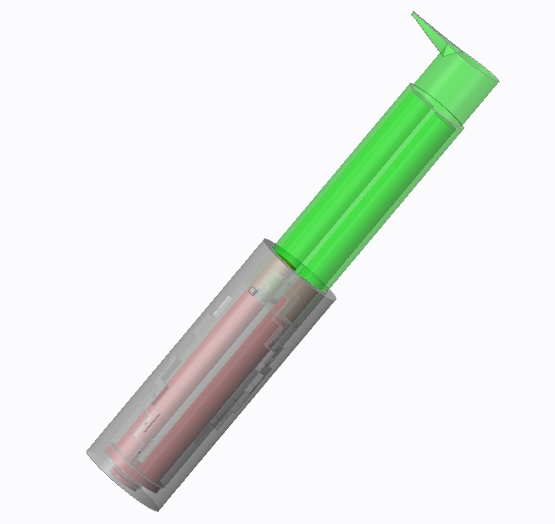
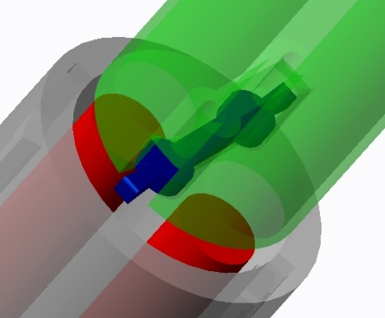
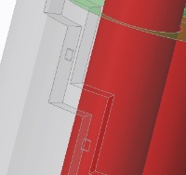
Creo2 Model
Concept-2-multiuse
Description:
Dual barrel
Hypothesis:
Transfer function:
Guide slot shell
plunger
Enablers: it will work since:
Disabler: it might not work since:
bump
Pull-back spring cover

Slide 9
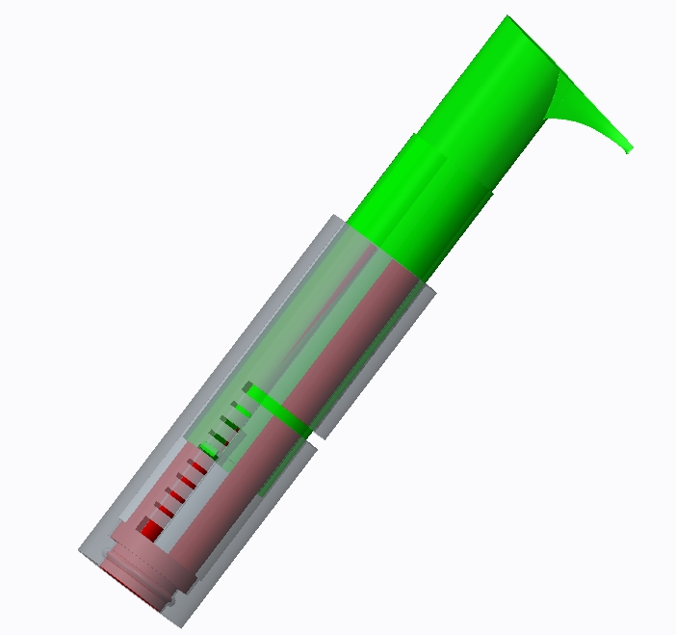
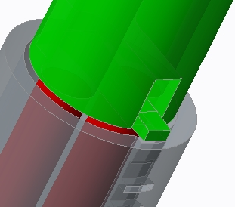
Creo2 Model
Concept-2-single use
Description:
Dual barrel
Hypothesis:
Transfer function:
Guide slot shell
plunger
Enablers: it will work since:
Disabler: it might not work since:
Feedback piece

Slide 10
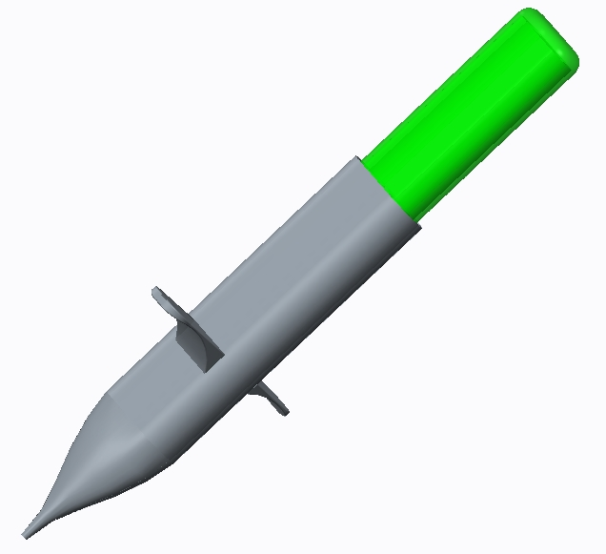
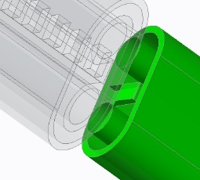
Creo2 Model
Concept-4-single use
Description:
Plunger
Hypothesis:
Transfer function:
Dual barrel
Enablers: it will work since:
Finger holder
Disabler: it might not work since:
Feedback slot
Feedback piece

Slide 11
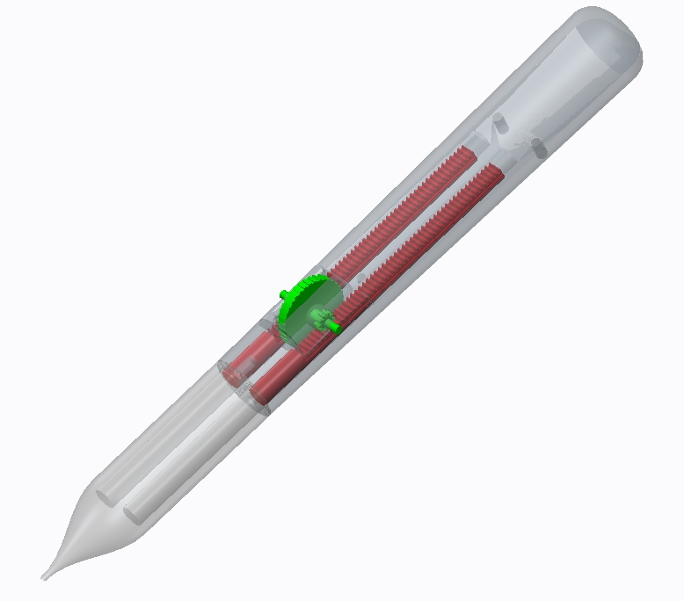
Creo2 Model
Concept-3
Description:
Hypothesis:
Gear rack plunger
Transfer function:
Cosmetics shell
Enablers: it will work since:
Single use barrel
Rolling wheel
Disabler:

Slide 12
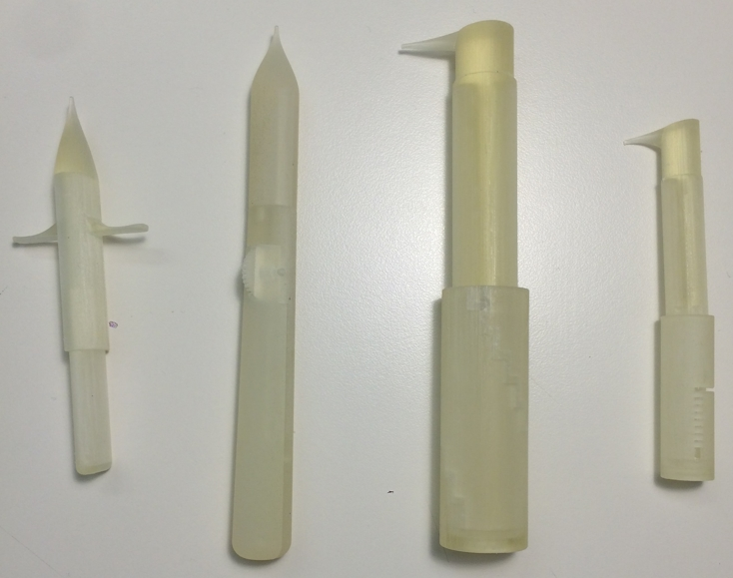
3D Printing Model

